Slide 1
Krispy Klean’s Car Wash
Aryn Sydnor
Gerardo Lopez
Dayna Ferguson

Slide 2

Background
Small owned car wash company.
Wash all cars by hand.
3 different car wash services
Types of employees:
1 customer representative
10 washers
5 dryers
1 manager

Slide 3
Need For Database
Average number of customers: 400 per week
Average number of sales: $5,000 per week
Store all critical information required to keep their business running smoothly
Without these processes/functions:
Krispy Klean would not be able to provide their customers with great service that is consistently efficient.

Slide 4
Advantages
Time-saving back office tracking calculations, many of which are based off of sales-batch reports
Customer information is easily accessible with a quick and easy search
Creation of tickets with an ID to track customer items and services and print receipts in a timely manner
Time clock to keep up with employees on and off the clock

Slide 5
User Requirements
Critical Information/Capabilities
Search customer accounts, create accounts, store customer information
Create and print tickets for the customer and the workers to keep track of cars being washed, along with their service details
Log, show, print money batch reports for all types of payments and billings
View batch reports at the end of each day.
Clock-in and clock-out for shifts

Slide 6
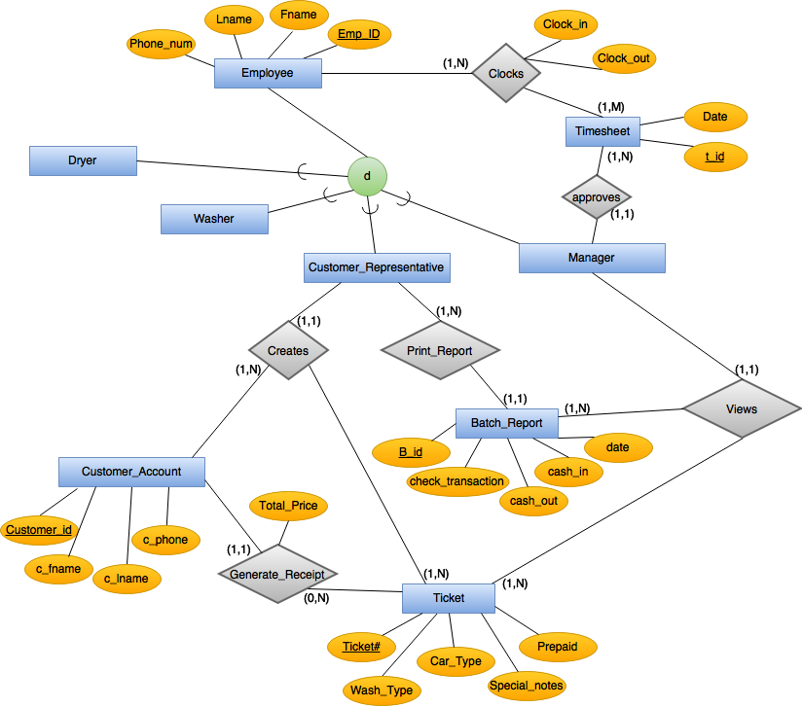
ERD

Slide 7
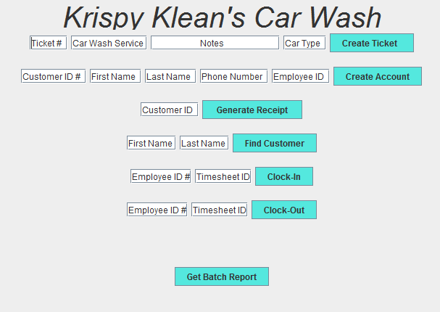
Functions
Create a Ticket
Create a Customer Account
Generate a Receipt
Lookup Customer’s Account Info
Clock-In
Clock-Out
Generate a Batch Report

Slide 8

1. Create a Ticket
Enter ticket information:
Ticket Number
Cleaning Type
Notes
Car Type
Click Create Ticket button

Slide 9


2. Create a Customer Account
Enter new customer information:
Customer ID
First Name
Last Name
Phone Number
Employee ID
Click Create Account button
3. Generate a Receipt
Enter the Customer ID
Click the Generate Receipt button

Slide 10

4. Lookup Customer Account Information
Enter the Customer’s first and last name
Click the Find Customer button
Message appears with the customer ID, name, phone number

Slide 11
6. / 7. Clock-In/Clock-Out
Enter employee ID and timesheet ID next to Clock-In/Clock-Out
Click Clock-In/Clock-Out button
8. Generate Batch Report
Click Get Batch Report button
Displays daily batch report ID, date, check transactions, card transactions, cash out, cash in, employee ID

Slide 12
Demonstration

